Slide 1


Slide 2
How to Use a Discount Code in the Registration Form

Slide 3
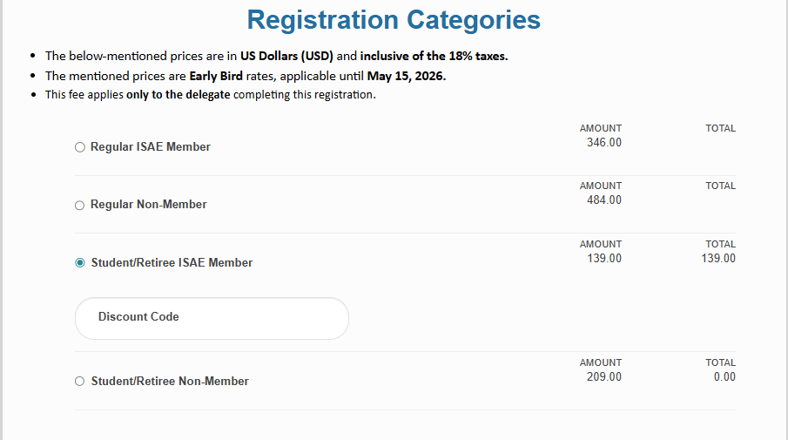
On the Registration Category page, selecting any category radio button will open the discount code field.
Disclaimer: Registration Type Compliance
Notice to All Users: Please be advised that the access codes provided are strictly calibrated to your specific Categories.

Slide 4
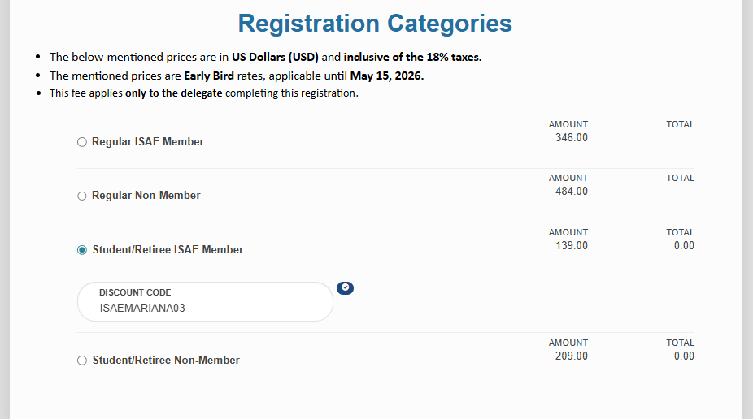
Please enter the discount code provided by us. The total amount will automatically update based on the discount percentage and a small tick will appear on the discount code field which means the code is applied successfully.

Slide 5
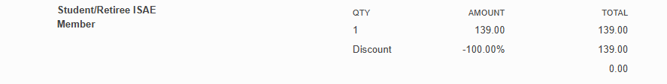
On the summary page, the total amount will be displayed along with the discount percentage and the discounted cost.

Slide 6
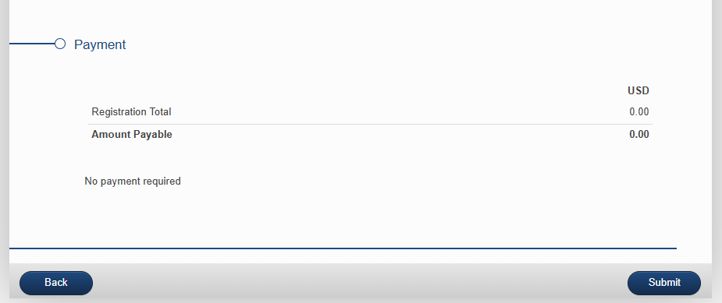
After summary page, the payment page will come. Just simply submit the form.

Slide 7

THANK YOU

